Slide 1



Final Presentation
Enabling second-life battery production.
Notes:
We are Amy and Joe, and we have joined LiFETIME, a startup company looking to enable the second-life use of Lithium-ion batteries.

Slide 2
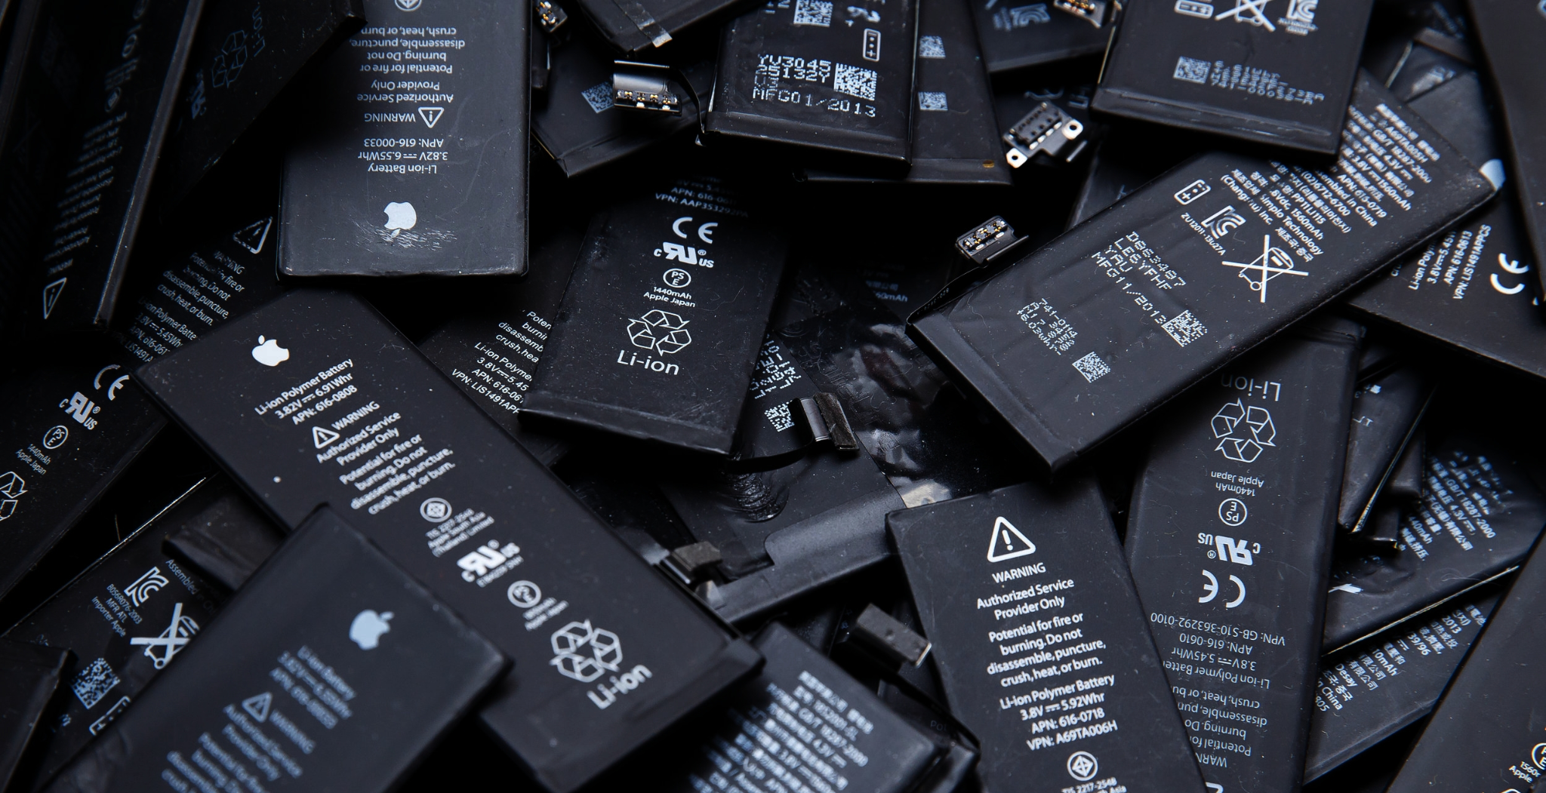
Image from Nano Magazine - https://nano-magazine.com/news/2018/6/13/the-technologies-which-are-revolutionizing-batteriesc
Notes:
[Joe] Li-ion batteries are everywhere…

Slide 3
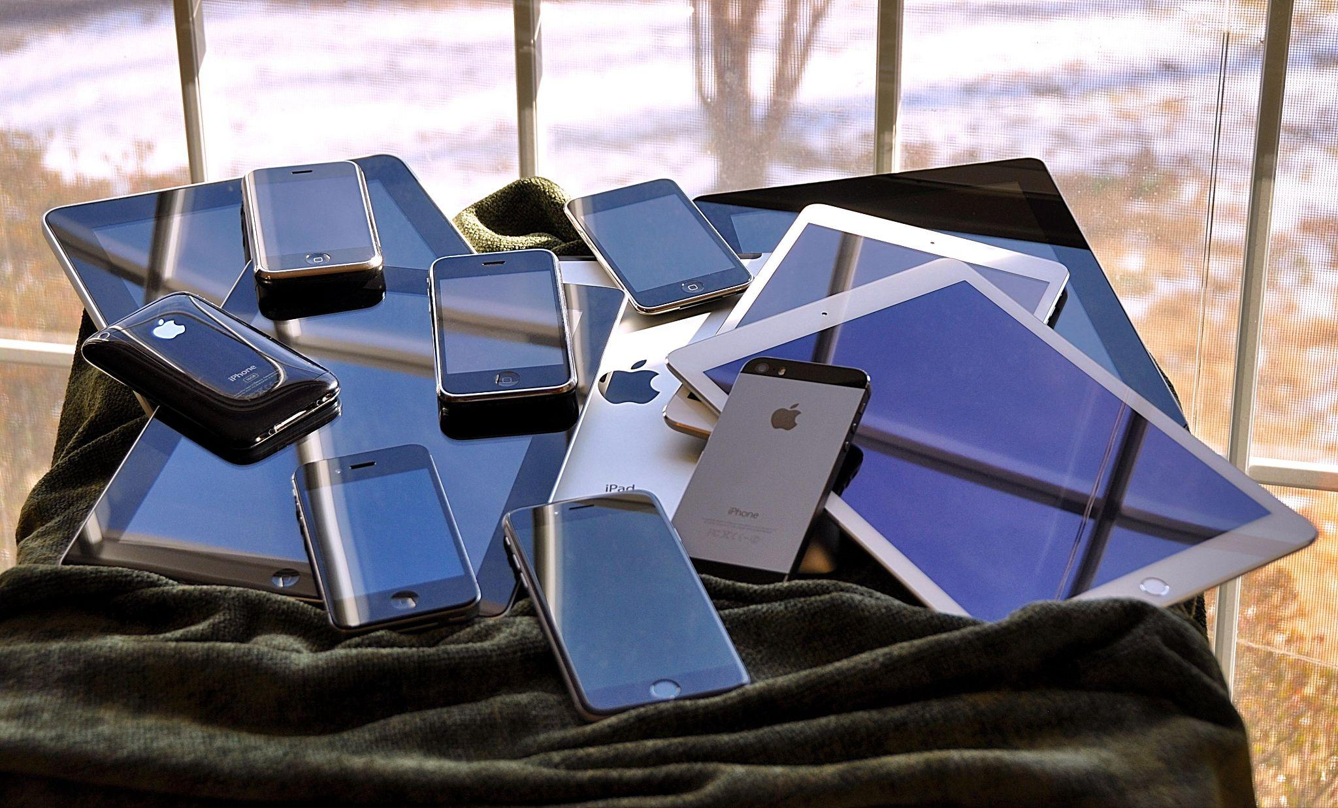
The iOS family pile (2015) - Blake Patterson via flickr. Licenced under Creative Commons By 2.0 Deed
Phones
Laptops
Tablets
Smart Devices
Notes:
[Joe] From phones and laptops to electric vehicles. But they eventually degrade, or the device they’re used in becomes obsolete.

Slide 4
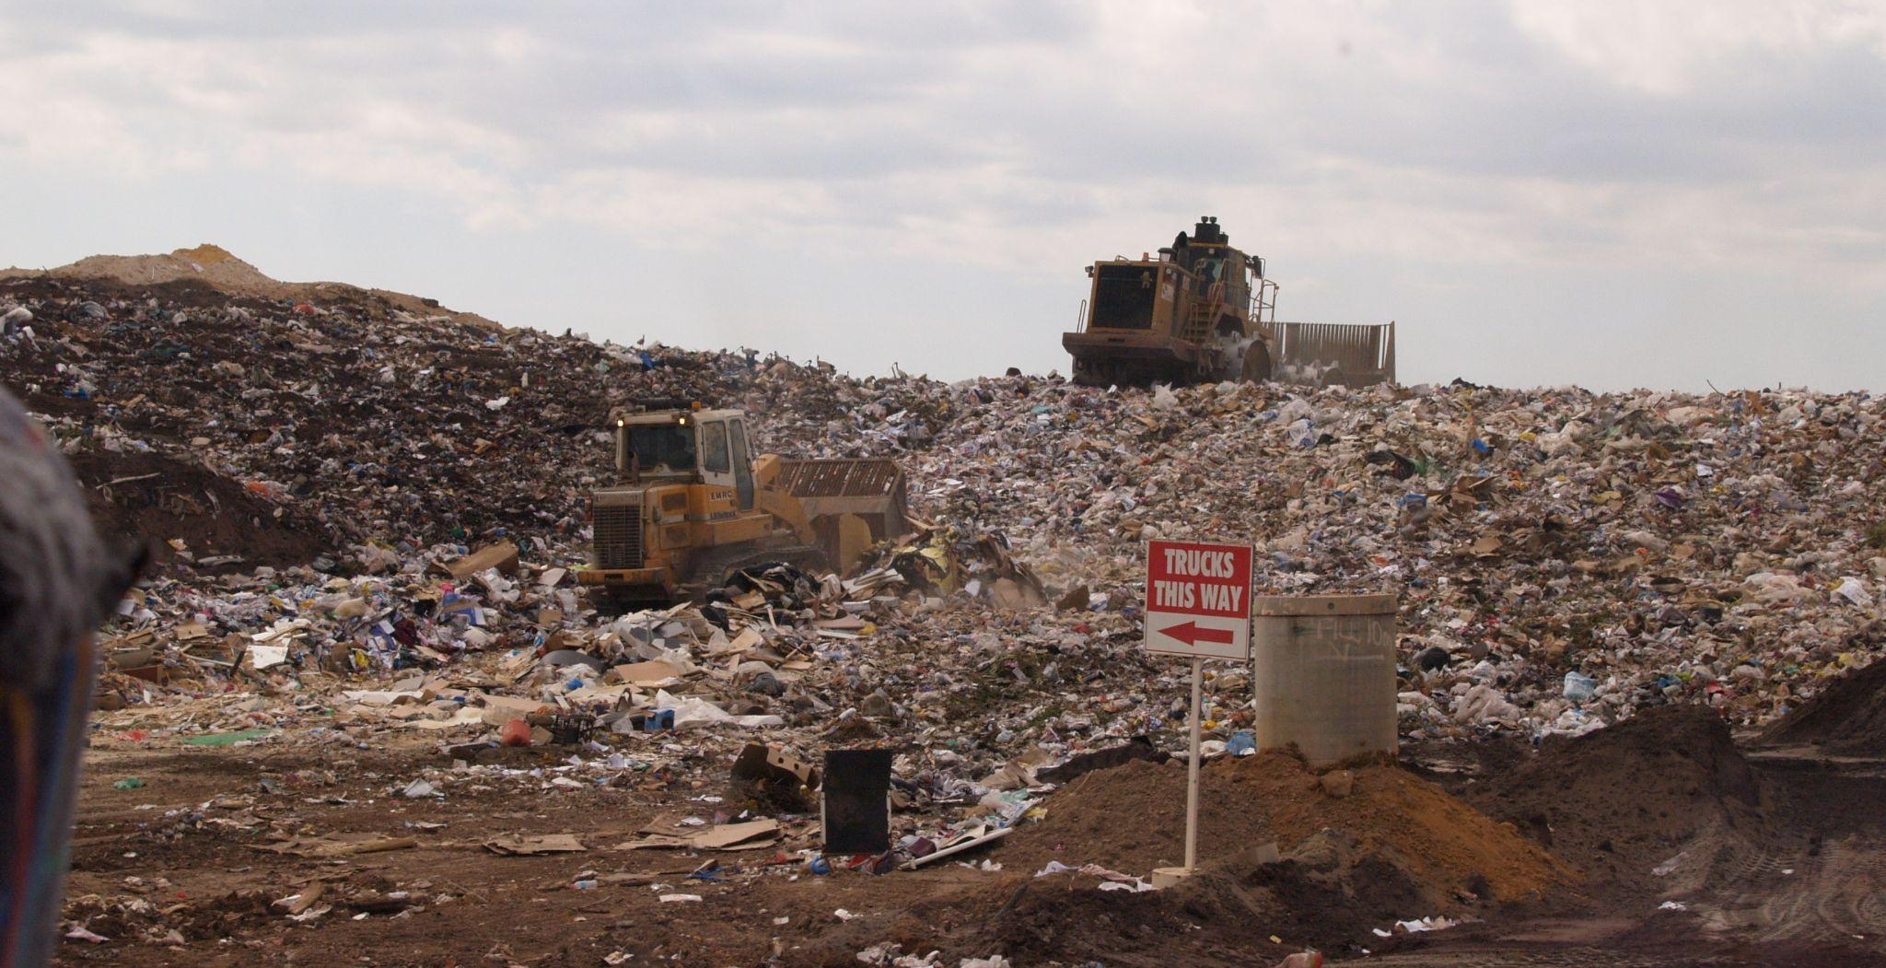


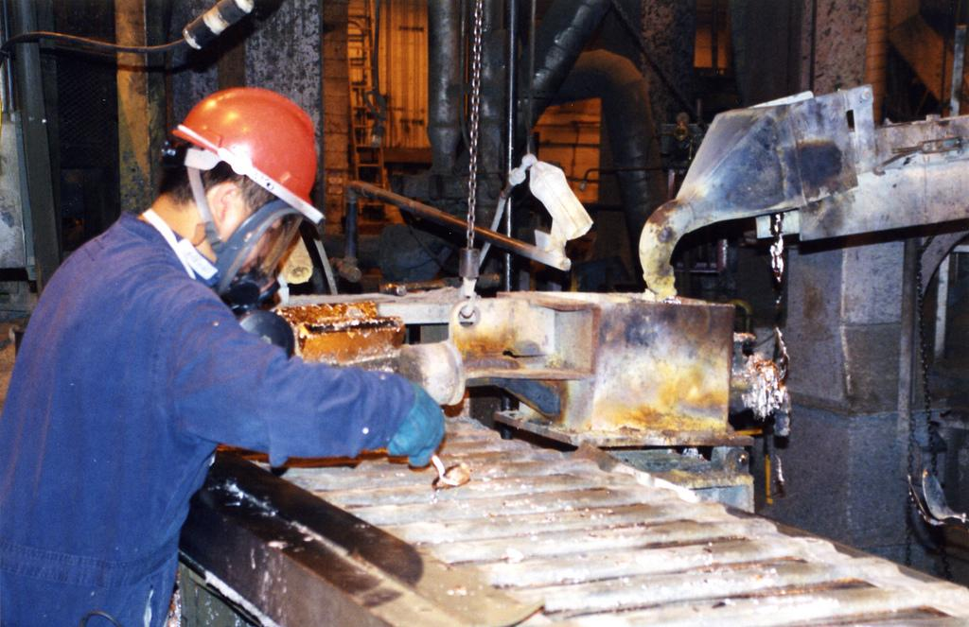
Image by Ashley Felton - Public Domain
Image from National Institute for Occupational Safety and Health (NIOSH) USA - Public Domain
Landfill
Recycling
Notes:
[Joe] Batteries are deemed to reach “end-of-life” (EOL) when they reach 70-80% of their original capacity. 95% are prematurely sent to landfill, and just 5% are recycled.

Slide 5

By User:Synth85 - Own work, CC BY-SA 4.0, https://commons.wikimedia.org/w/index.php?curid=75041978
Notes:
[Joe] Where they can start fires that pollute the environment and release toxic gases harming locals and wildlife.

Slide 6
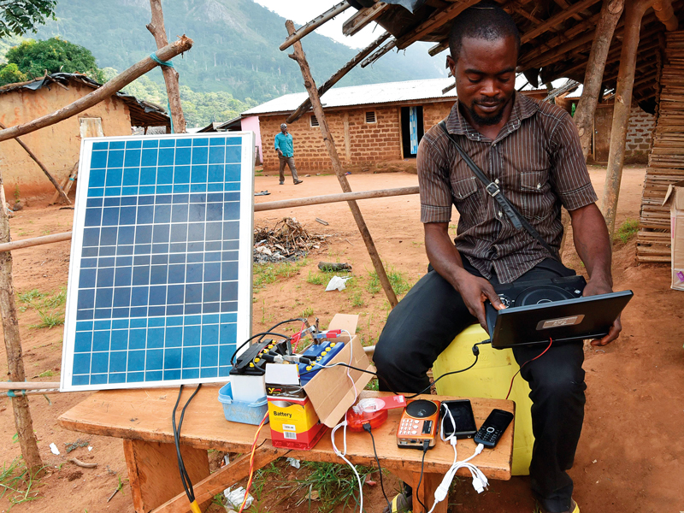
Image from The New Economy: Schneider Electric is helping to bring reliable electricity to Africa
Notes:
[Amy] With the increase in prevalence of solar power and other less reliable renewable energy sources, the demand for batteries is increasing.
This is matched with an increase in battery use in the developed world, especially in EVs, which mean there is expected to be an increasing supply of end of life batteries.
#In rural areas where power supply is variable, second-life batteries could be used in hospitals to run oxygen concentrators or life support machines during outages or overnight.
#Increasing energy accessibility also enables alternative earnings, such as allowing crop farmers to run irrigation pumps powered by solar-battery systems for higher yield, and helps to reduce rural-urban developmental inequalities.

Slide 7

By Varistor60 - Own work, CC BY-SA 4.0, https://commons.wikimedia.org/w/index.php?curid=59368531
Notes:
[Amy] The batteries would enable stable electrification in areas where the infrastructure for grid electricity doesn’t exist or is too unreliable.
For example, in South Africa where ‘load-shedding’ or scheduled power outages are a daily challenge, affordable batteries would give security to small business owners, allowing them to run internet, fridges, payment machines and keep their lights on.

Slide 8
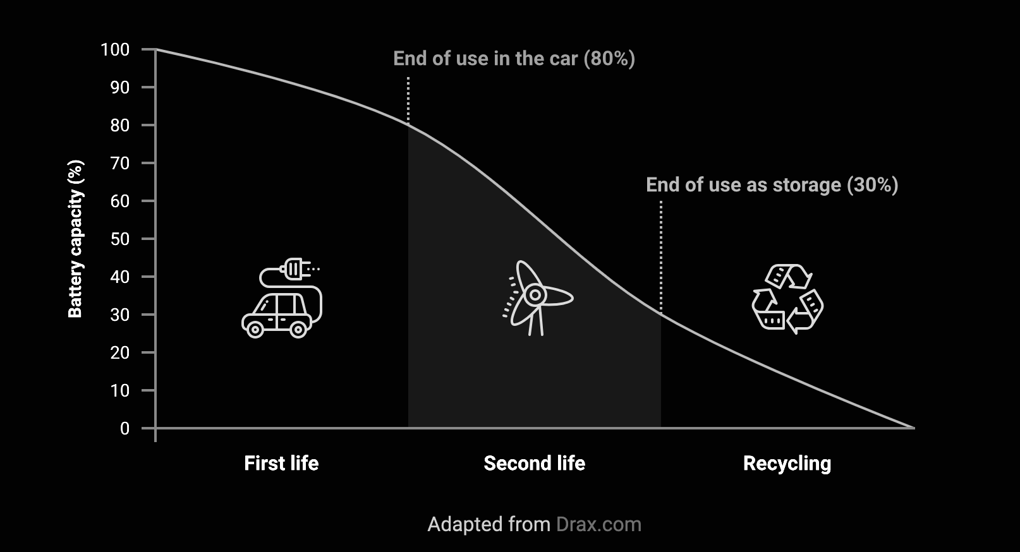
Notes:
[Joe] This is where LiFETIME steps in. They are looking to provide a low-cost, open-source solution for battery health testing for second-life battery applications. Essentially, they hope to provide a cheap device that will quickly measure how much future potential a battery still has left, allowing the operator to decide whether it can continue to be used, and for which purposes.

Slide 9



Notes:
[Amy] We believe that the work of LiFETIME and their product has the potential to contribute to Sustainable Development Goalss 7, 11 and 12. Inline with inclusive innovation practices, it responds to a genuine need and adds significant value.

Slide 10

What is a Li-ion Battery?
The Strategy of Achieving Flexibility in Materials and Configuration of Flexible Lithium‐Ion Batteries - Scientific Figure on ResearchGate. Available from: https://www.researchgate.net/figure/Schematic-diagram-of-working-mechanism-of-lithium-ion-battery_fig1_356134415 [accessed 3 Jun, 2024]
Li+
Li+
Li+
Li+
The Strategy of Achieving Flexibility in Materials and Configuration of Flexible Lithium‐Ion Batteries - Scientific Figure on ResearchGate. Available from: https://www.researchgate.net/figure/Schematic-diagram-of-working-mechanism-of-lithium-ion-battery_fig1_356134415 [accessed 3 Jun, 2024]
Notes:
[Joe] On the inside, a lithium ion battery has two plates that can hold Lithium ions.
The middle layer acts like a sieve, allows lithium ions to pass, but electricity can’t.
What does a lithium ion battery look like, how does it work and how does it lose capacity

Slide 11

What is a Li-ion Battery?
The Strategy of Achieving Flexibility in Materials and Configuration of Flexible Lithium‐Ion Batteries - Scientific Figure on ResearchGate. Available from: https://www.researchgate.net/figure/Schematic-diagram-of-working-mechanism-of-lithium-ion-battery_fig1_356134415 [accessed 3 Jun, 2024]
Li+
Li+
Li+
Li+
The Strategy of Achieving Flexibility in Materials and Configuration of Flexible Lithium‐Ion Batteries - Scientific Figure on ResearchGate. Available from: https://www.researchgate.net/figure/Schematic-diagram-of-working-mechanism-of-lithium-ion-battery_fig1_356134415 [accessed 3 Jun, 2024]
Notes:
When you charge it, the lithium ions move from one side to the other to equalize out the electricity you put in.

Slide 12
What is a Li-ion Battery?
The Strategy of Achieving Flexibility in Materials and Configuration of Flexible Lithium‐Ion Batteries - Scientific Figure on ResearchGate. Available from: https://www.researchgate.net/figure/Schematic-diagram-of-working-mechanism-of-lithium-ion-battery_fig1_356134415 [accessed 3 Jun, 2024]
Li+
Li+
Li+
Li+
The Strategy of Achieving Flexibility in Materials and Configuration of Flexible Lithium‐Ion Batteries - Scientific Figure on ResearchGate. Available from: https://www.researchgate.net/figure/Schematic-diagram-of-working-mechanism-of-lithium-ion-battery_fig1_356134415 [accessed 3 Jun, 2024]
Notes:
When you discharge it, the opposite happens, but since the electricity can’t go through the battery, it goes through whatever you’re trying to power.
The primary way lithium batteries lose capacity when the lithium gets stuck.
Different lithium batteries can have different materials used in them, giving them different properties. But they all fundamentally work the same way.

Slide 13
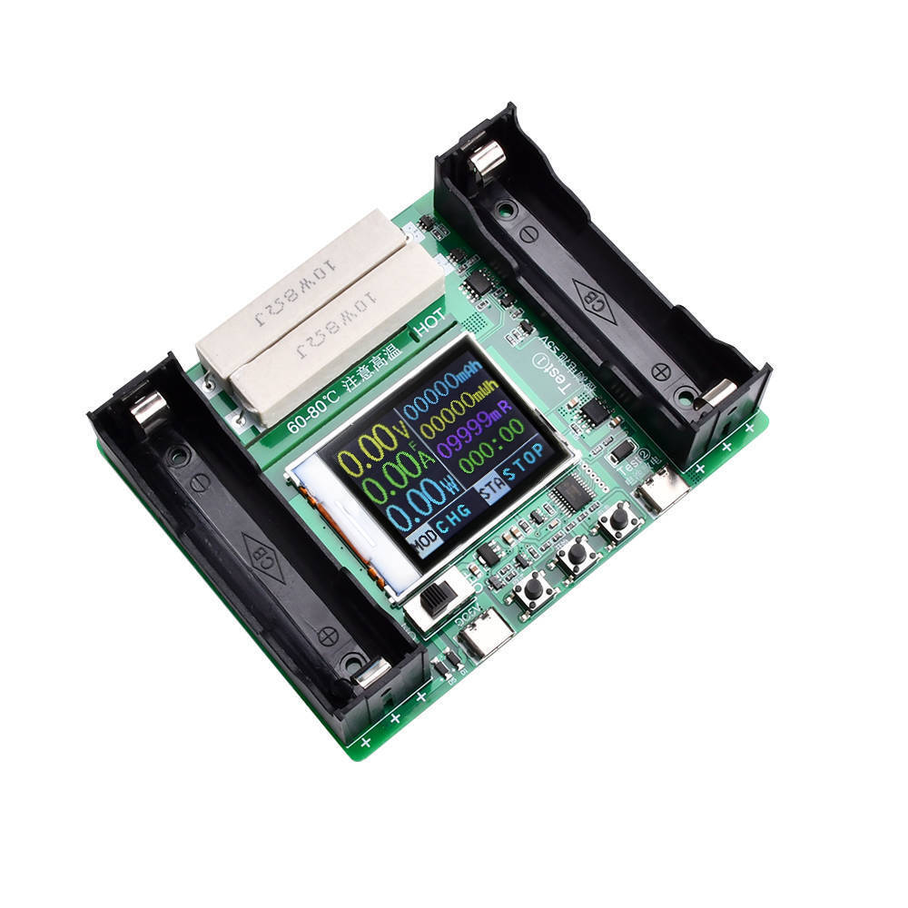
Image from eBay
Notes:
LiFETIME ran a series of cells of through a cell cycler, charging and discharging them hundreds of times.

Slide 14
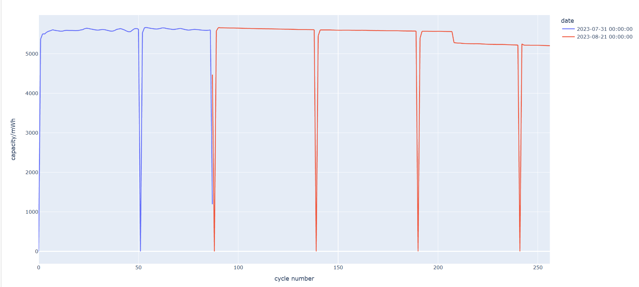
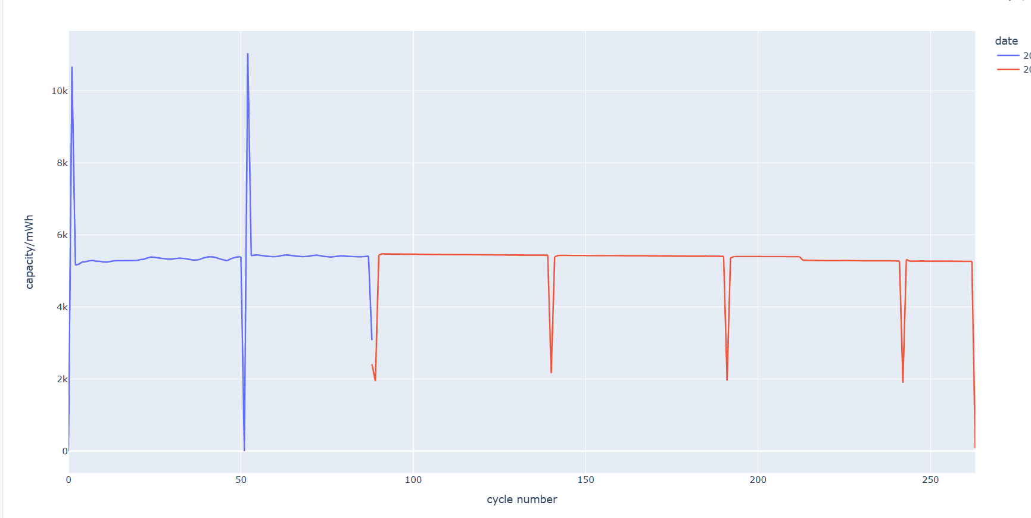
Lithium-Phosphate
Used in energy storage and off-grid living.
Low capacity loss over time.
Heavier, Larger.
Notes:
[Joe] We looked through this data, and we were able to determine how much capacity the cells lost over these cycles. Anomalies exist in the data because of the way the testing was performed, which more work is needed to filter out.
Shown here is the capacity over time of two Lithium phosphate cells, like those used in solar energy storage and off-grid living. They barely lose any of their capacity, even after 250+ cycles. These batteries are less common because they’re generally heavier and larger.

Slide 15
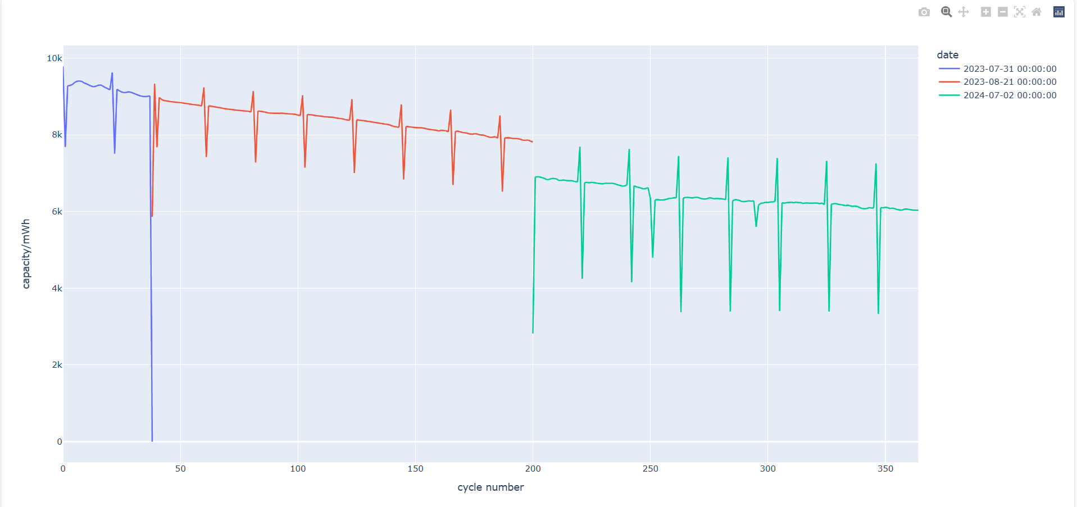
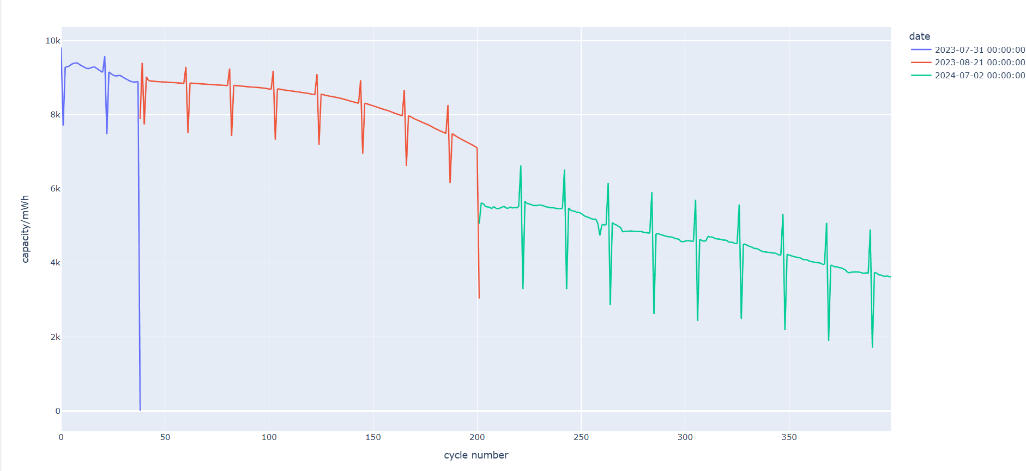
Lithium-Cobalt
Used in portable applications (phones, tablets, cars)
High capacity loss.
Lighter, smaller.
Notes:
[Joe] By contrast, the type of Lithium-cobalt cells used in your phone, laptop or car degrade pretty quickly. These cells were tested again 5 months later (the green line), where you can see that storing them charged in a box for a few months has severely degraded their capacity. You can also see that two cells that are identical to begin with, degrade very differently over the same life.

Slide 16
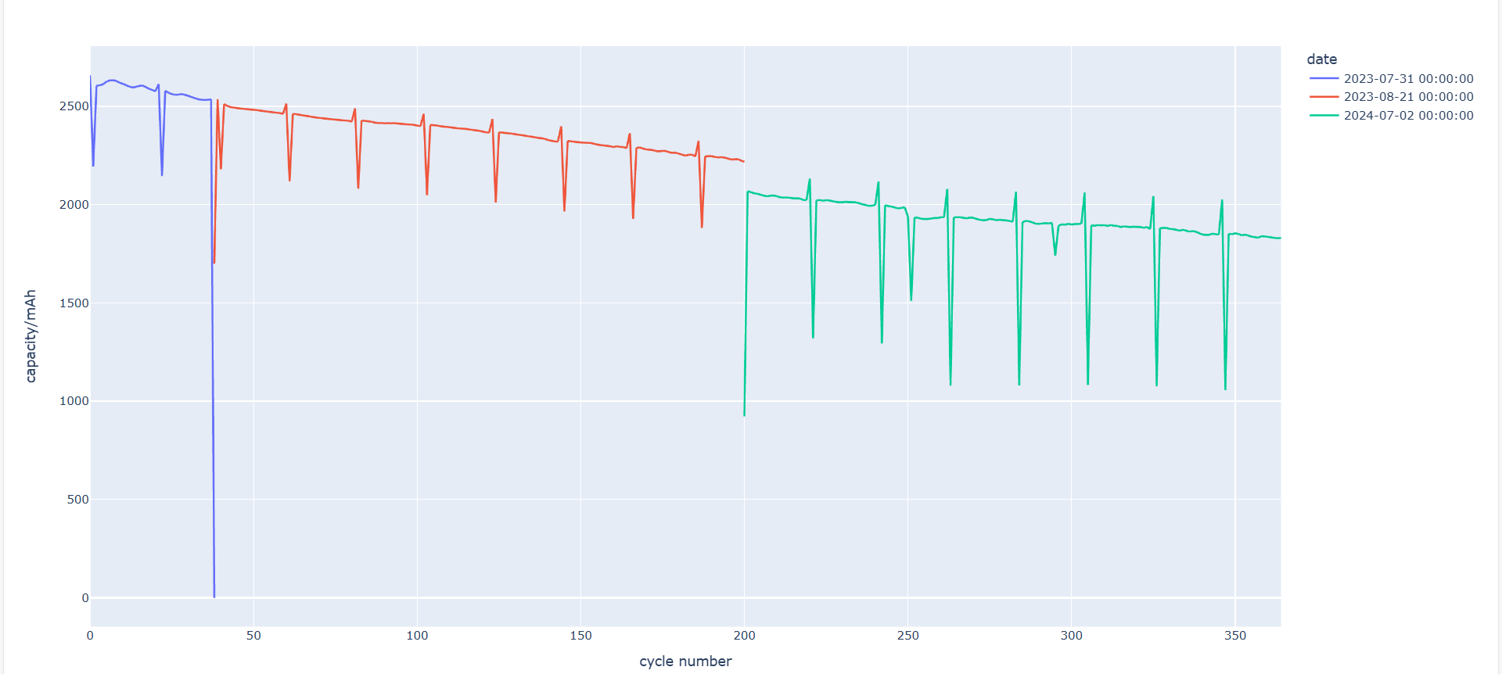
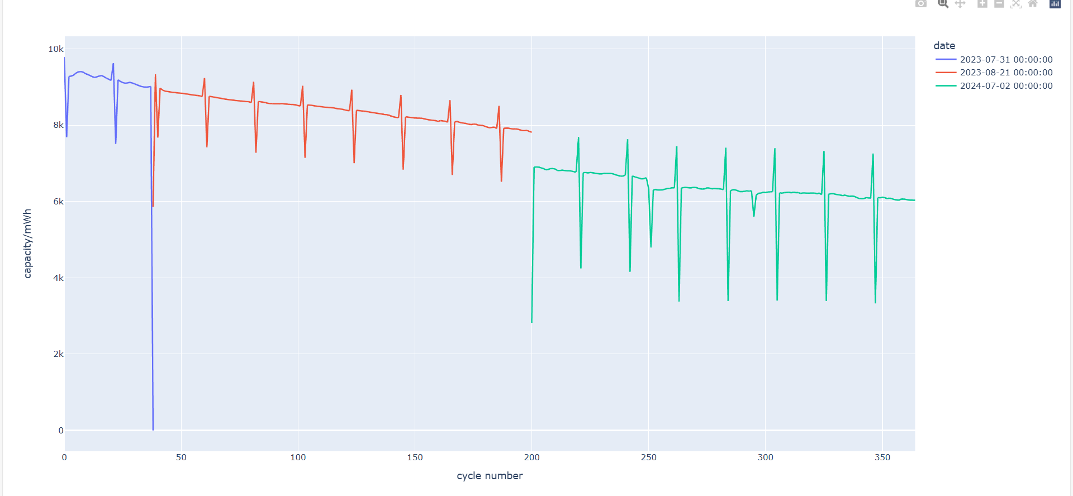
Power = Voltage x Current
Capacity (mWh)
Capacity (mAh)
Notes:
[Joe]
Further complicating things is voltage fade, where the cell voltage changes, reducing the amount of power it can output.
Because of this we can measure capacity in two different ways, in mWh and mAh.
In this test the first decreases by 65%, the second by 69%

Slide 17
The problems with predicting battery health.
Cycling data is expensive
Degradation depends on:
Charging and Discharging (Speed, Depth)
Temperature
Cell chemistry
Time spent charged.
Future life application depends on the process which degraded.
Notes:
So why hasn’t it already been done? It’s really difficult.
Cycling data is expensive -> there are only a few academic datasets available.
Degradation is complex! Depends on:
Charging and Discharging (Speed, Depth)
Temperature
Cell chemistry
Time spent charged.
Future life application depends on the process which degraded.
As we saw with the lifetime data, it can be very different even for cells with identical lives. Different modes by which batteries can degrade means that the future life application depends on the process by which it degraded.

Slide 18
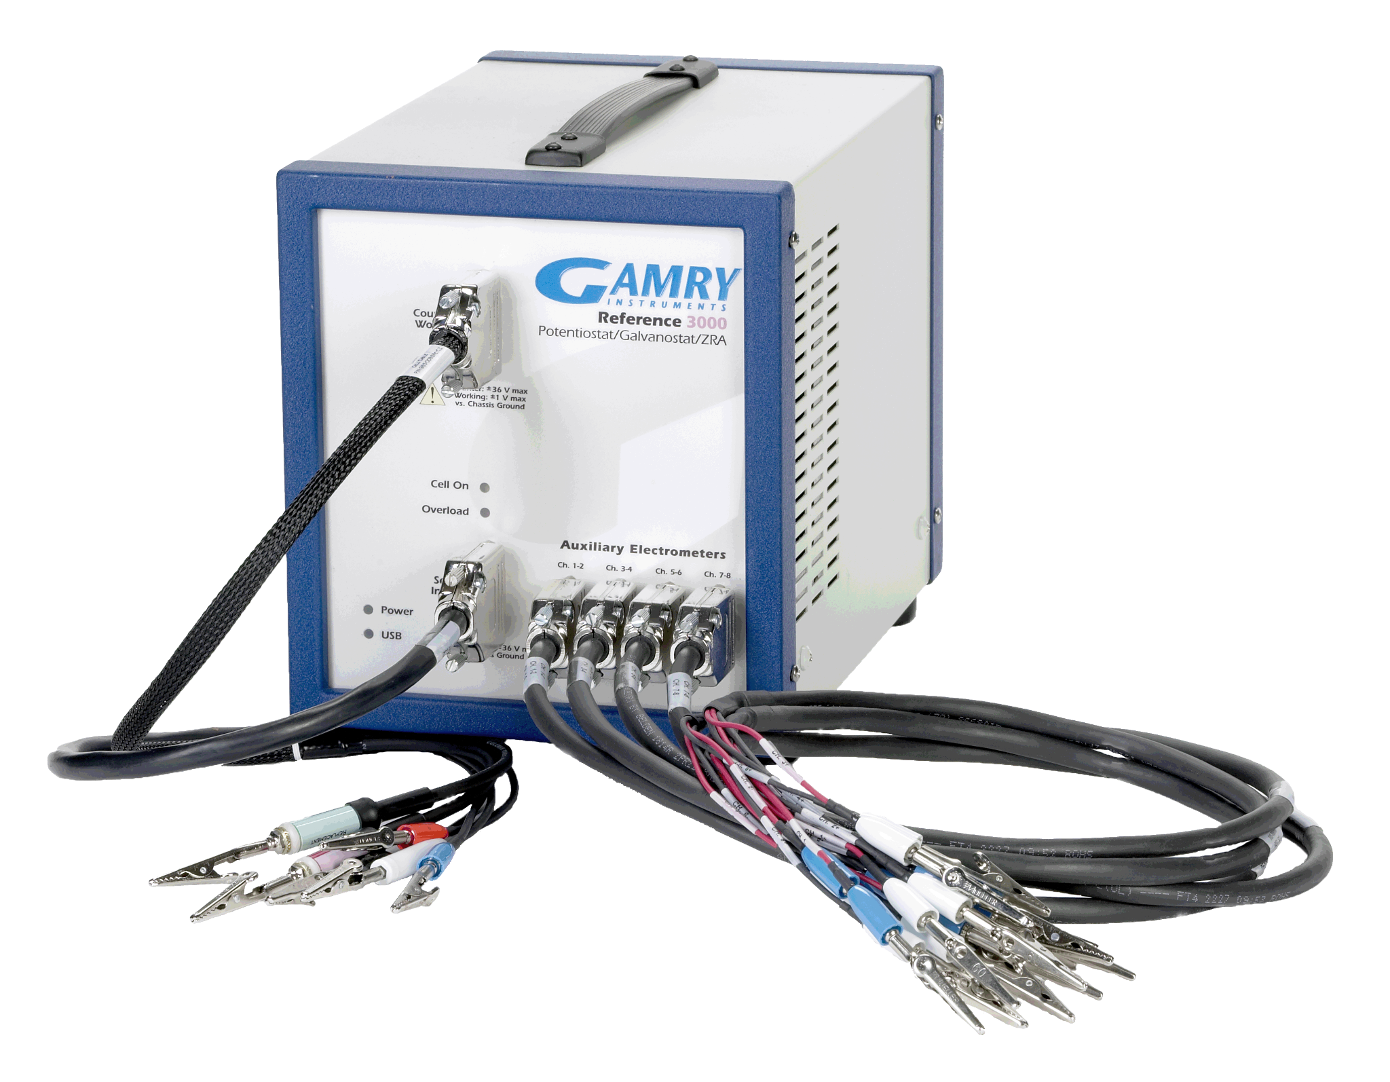
EIS: A different approach
EIS = Electrochemical Impedance Spectroscopy
EIS Testing Equipment
Notes:
[Amy] EIS, or electrochemical impedance spectroscopy is a measurement technique used by scientists to get information about the processes that are happening inside a battery.
Different chemical reactions in the cell happen at different speeds, so if we run electricity through the battery at different speeds and take measurements, we can draw this plot, called a spectrum.

Slide 19
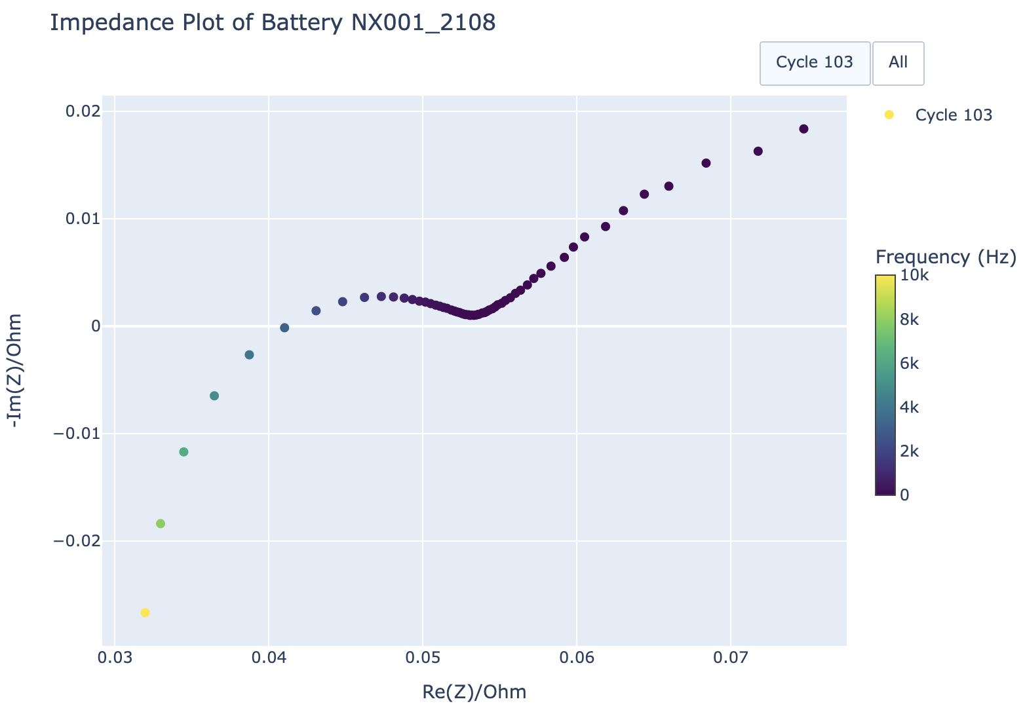
An example of an EIS spectrum
Increasing speed
Notes:
[Amy] Different chemical reactions in the cell happen at different speeds, so if we run electricity through the battery at different speeds and take measurements, we can draw this plot, called a spectrum. Moving down the plot from the top right indicates faster speeds.

Slide 20
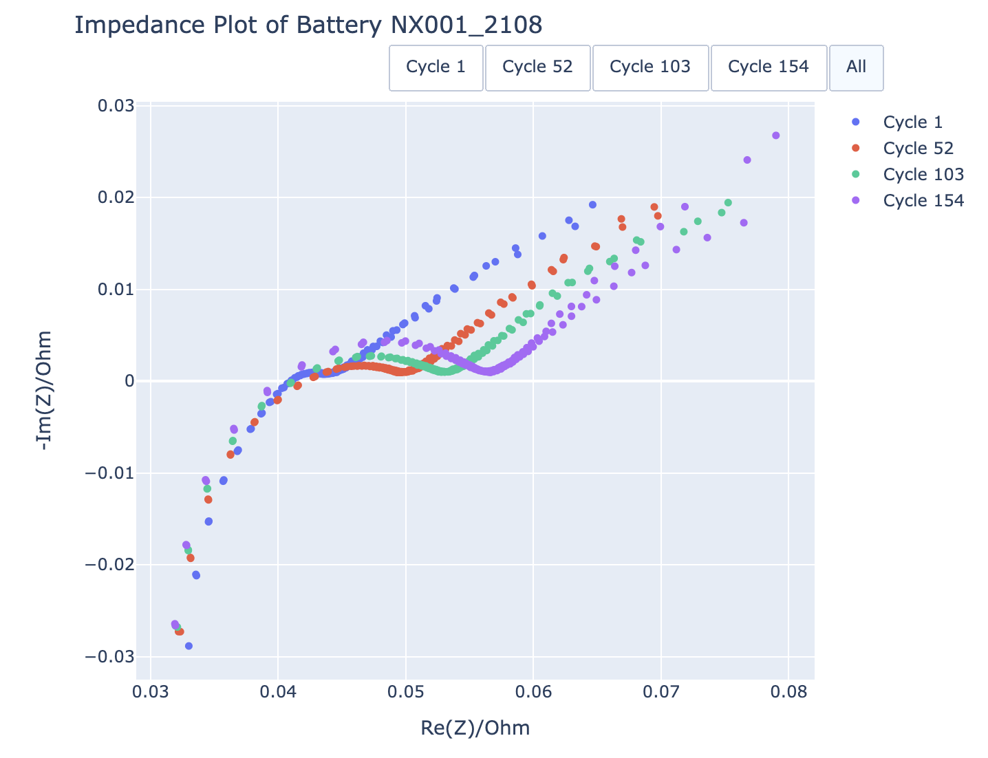
Increasing number
of cycles completed
by the battery
Notes:
[Amy] The shape of the graph changes with the capacity of the battery. Here are four tests, increasing in age from left to right.
The shape of the graph gives us a hint as to what is going on inside the cell, and this is what we want to take advantage of. When we measure the EIS for a new battery, we want to be able to use the graph to create a simulation of what’s happening inside the cell. This means we can run tests on a computer instead of on a battery.

Slide 21


Why is EIS useful?
Time
Cost
Energy
Notes:
[Joe] EIS takes less than 15 minutes to run, so it’s much more convenient than using cycle data, which can take hours or even days to record. And, as we’re not fully charging and discharging the battery each time, it saves energy too. Once you own the equipment to do the testing, we think it’s a much cheaper way to test cells.

Slide 22

How do we use the EIS graph to simulate what’s going on inside the battery?
?
Notes:
[Amy] How do we use the EIS graph to simulate what’s going on inside the battery? We create a model based on something we already know how to analyse… a circuit!

Slide 23
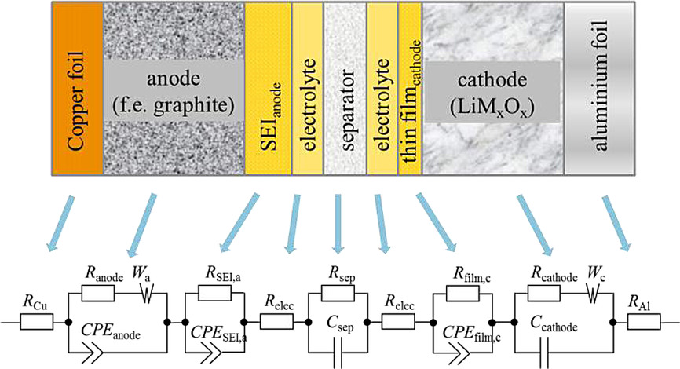
Westerhoff, U., Kurbach, K., Lienesch, F. & Kurrat, M., 2016. Analysis of Lithium-Ion Battery Models Based on Electrochemical Impedance Spectroscopy. Energy Technology, 4(12), pp.1620-1630. Available at: https://doi.org/10.1002/ente.201600154.
Notes:
[Amy] We find an equivalent electronic circuit, with wires, resistors and capacitors, that we can simulate on a computer. We choose the components of the circuit so that the graph produced on a computer matches the graph produced when we run it on the real battery. Each component in the circuit relates to something physical inside the real battery, as you can see on the slide.

Slide 24
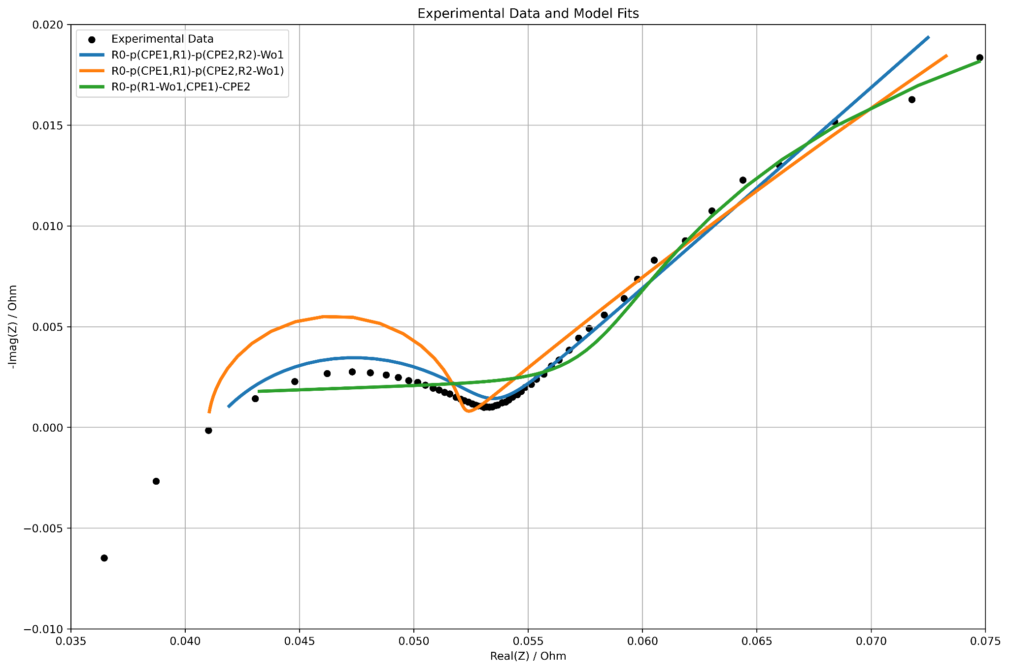
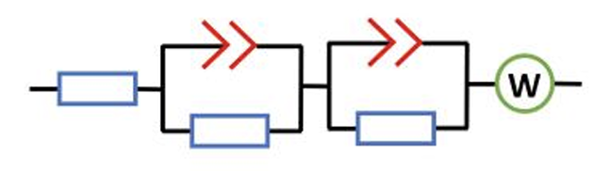
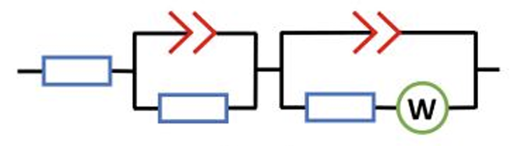
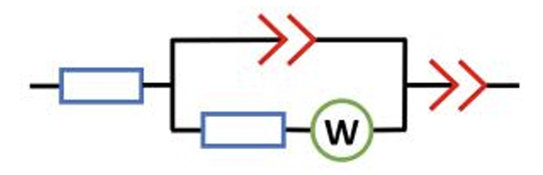
Fitting a circuit to EIS
Notes:
[Amy] Here’s an example of fitting a circuit to our EIS data that we have completed. Clearly, some circuits are a great fit, like the blue line, and some fit much less well. This is because of the different components used in the circuit model, and how well they relate to the aspects of the physical battery.

Slide 25
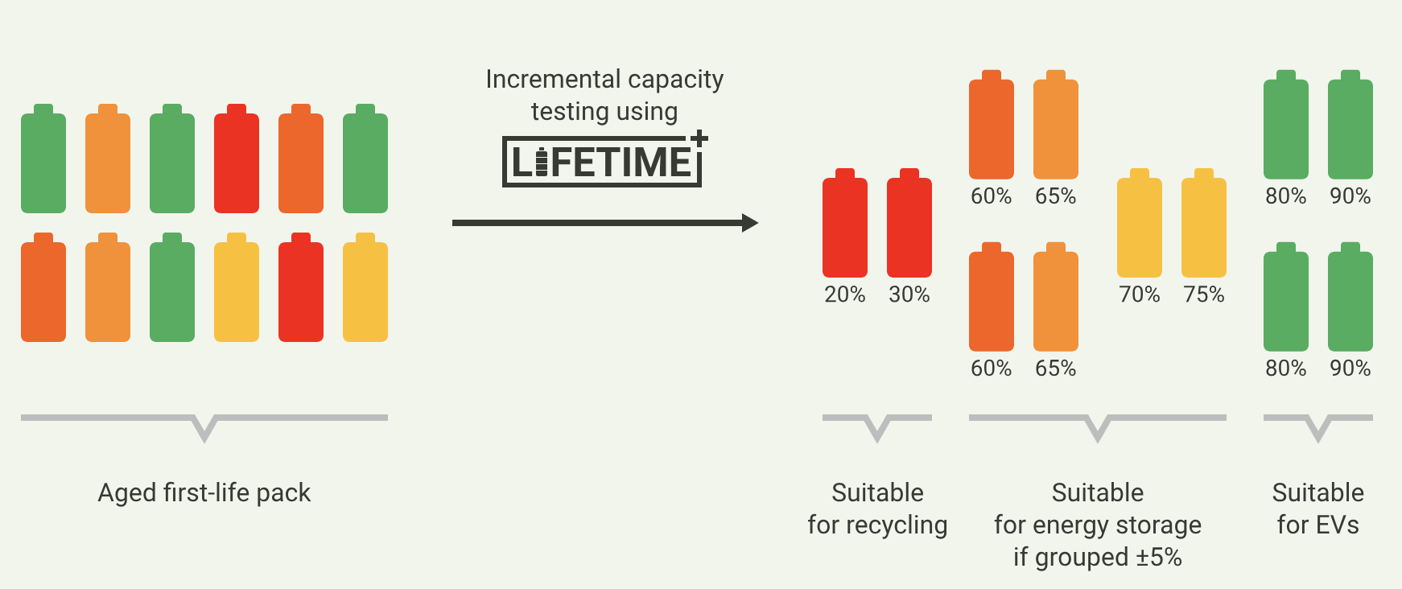
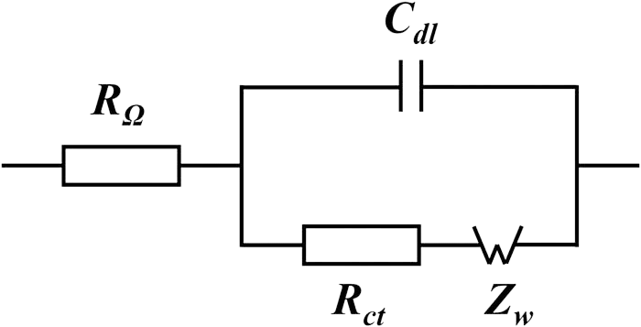
How does this help LiFETIME reach their goal?
Collect EIS data from batteries
10-15 minutes
Device outputs remaining capacity
Computer simulation
Notes:
[Joe]
The goal of our project was to take EIS data and try to find an equivalent circuit to match. The equivalent circuit model allows us to run tests on a computer without having to record more data from the physical battery.
This will mean that a battery can have just one EIS test done using the LiFETIME device, taking as little as 10 or 15 minutes
The computer will fit the EIS data to an electrical circuit model and runs analysis on the virtual circuit
which will give the results needed for the device to tell the user how much longer the battery can be expected to last, including information about parts of the battery that might be failing or fail next.

Slide 26
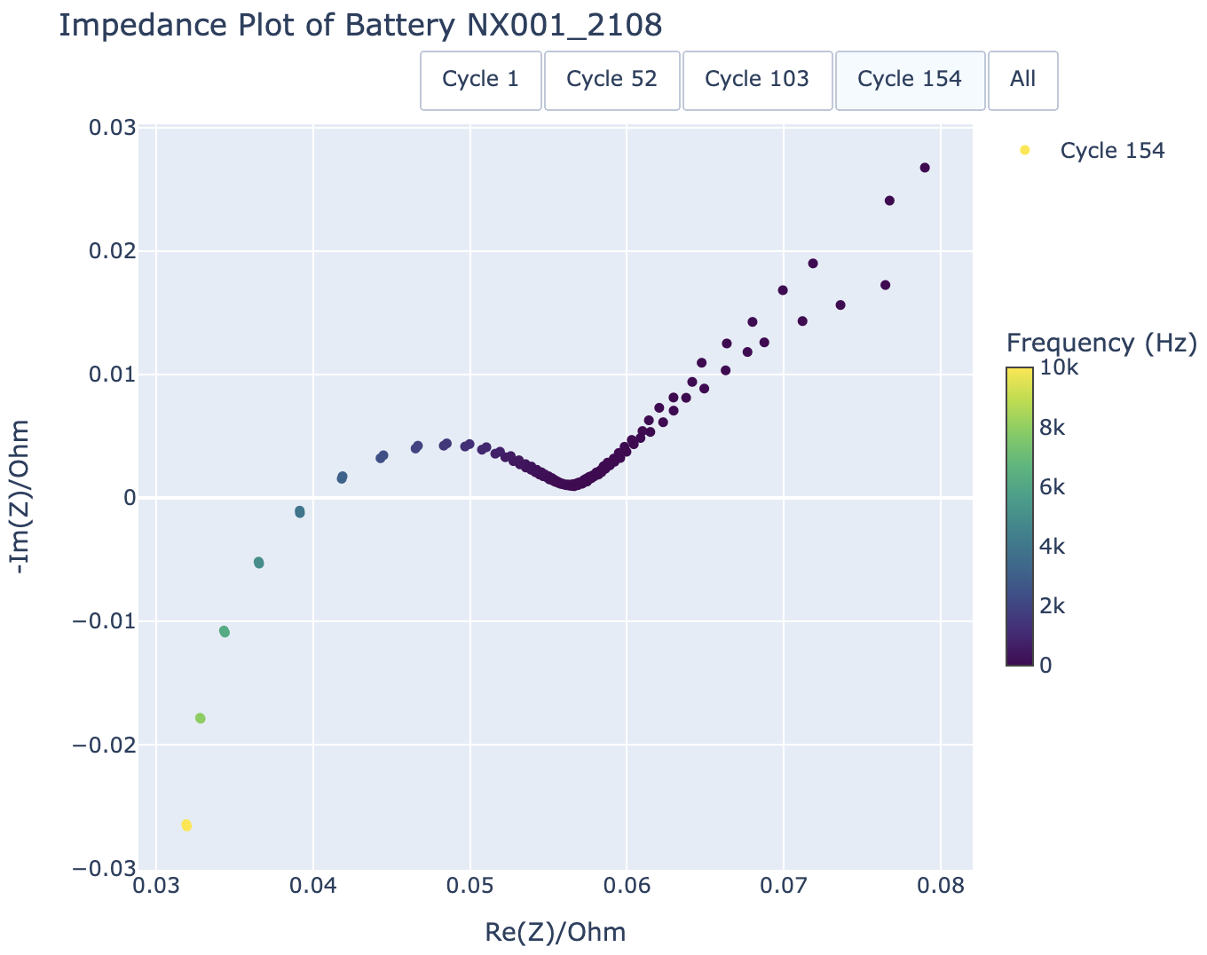
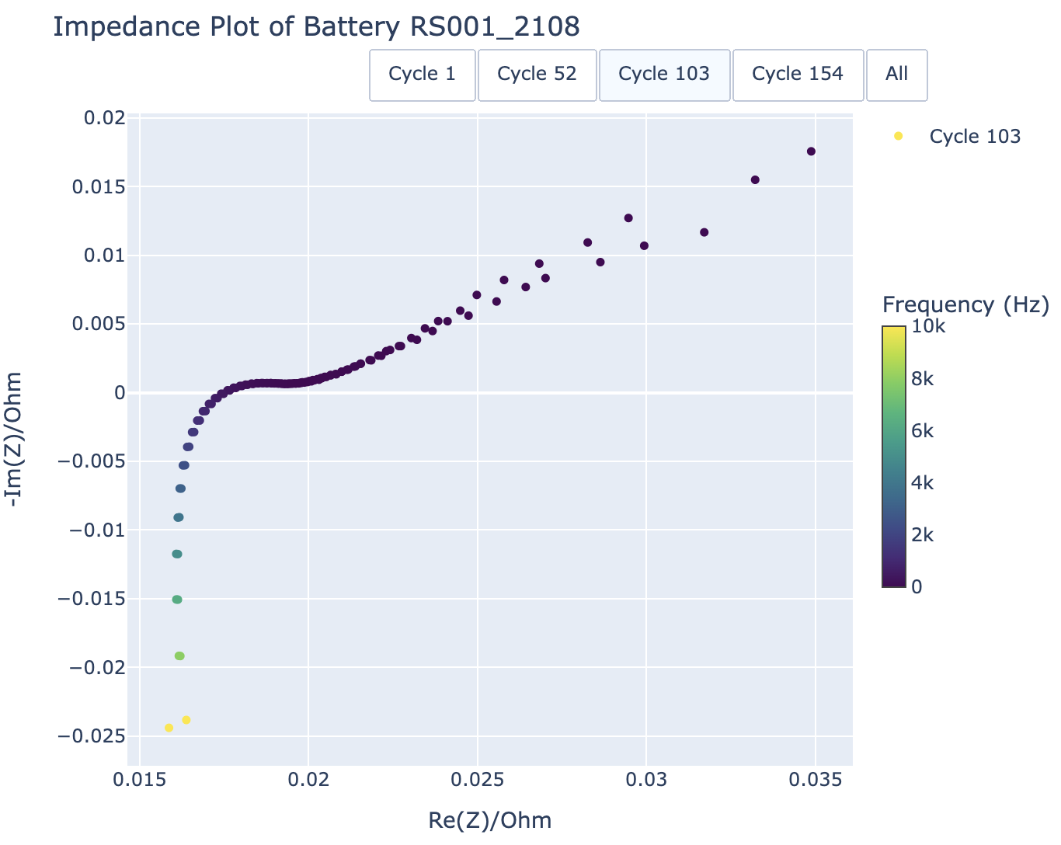
Challenges of fitting circuit models
Notes:
One way we’re helping LiFETIME reach this end product, is by reporting the challenges of fitting a circuit model to EIS data.
One challenge is that a circuit that fits well for one battery chemistry does not fit well with other batteries, as you can see, the spectra shown on the slides have different shapes.
Another challenge is the fact that EIS spectra are different for different states of charge.
For example if you do the test when the battery is at 20% charge, you will get a different result to doing it say, at 50 or 80%.
Additionally, there are lots of different software packages that can be used to do this fitting, so this is something else we’ve investigated for LiFETIME.

Slide 27



Software packages for circuit fitting
impedance.py
Notes:
Additionally, there are lots of different software packages that can be used to do this fitting, so this is something else we’ve investigated for LiFETIME.
Some software is very specific to EIS, while others, such as scipy, are software for general optimisation.

Slide 28
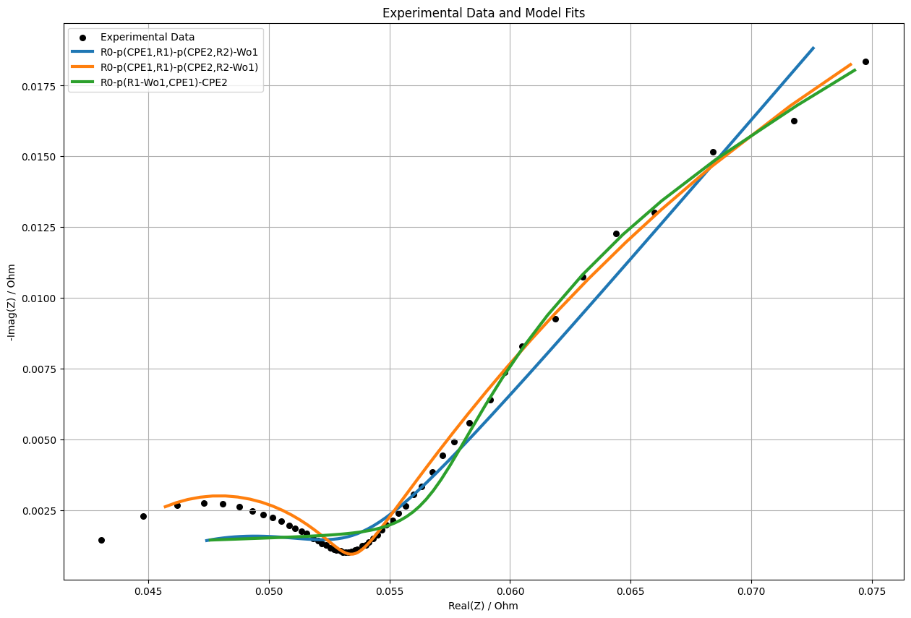
Impedance.py
Notes:
First we tried Impedance.py, a python package designed specifically for this purpose, which gave a great fit, but was extremely slow

Slide 29
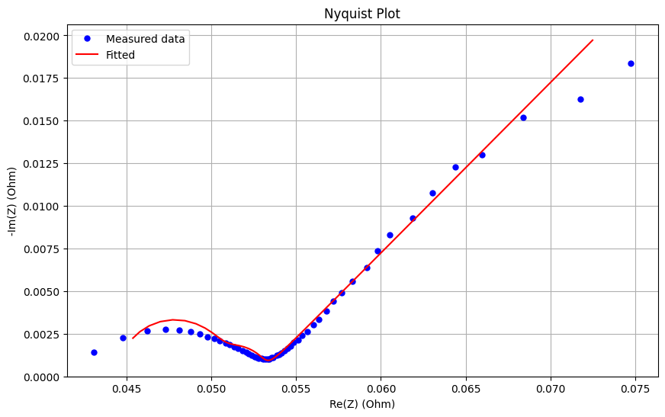
Scipy.optimize
Notes:
Next we tried SciPy, which was much quicker but worse fit, as the data in the middle of the plot is incorrectly weighting the result

Slide 30
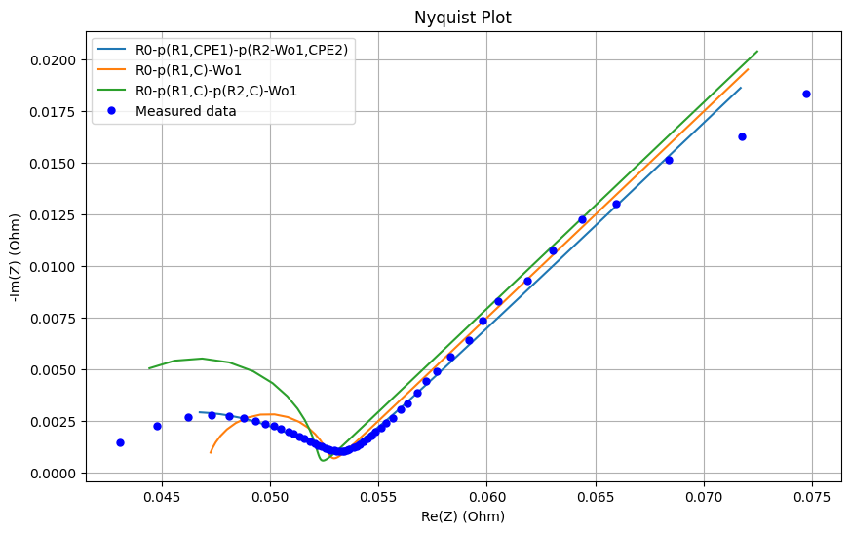
Scipy.optimise.curve_fit with KDE
Notes:
We improved this plot with something called Kernel Density Estimation.
The idea of this is to sample data points proportionally to how close together they are.
You can see that the blue line shows a much improved fit.
This is all still a work in progress, but we can pass our findings back to LiFETIME so that they can continue with our work and improve on our analysis.

Slide 31

Summary
Capacity analysis
EIS testing
Fitting to a circuit model
Notes:
[Joe] In summary,
Battery degradation is complex, and is affected by a number of different factors.
The most common way of testing batteries is by cycling them over and over again.
[Amy]
We think EIS is a better way of testing cells. Using an equivalent circuit model enables a computer to predict how the batteries will behave in their future life.
This has huge potential to reduce battery waste and provide affordable energy storage for all.
[Joe]
We were honoured to join LiFETIME for four weeks to complete research into capacity analysis, EIS and equivalent circuit modelling, and we hope our findings will help LiFETIME as they develop their product.

Slide 32
References
Slides 4,5:
Brown M, Hilton M., Crosette S. et Al (2021). Cutting Lithium-Ion Battery Fires in the Waste Industry, Eunomia [Link]
United Nations Institute for Training and Research. (2024). Leading countries based on electronic waste generation worldwide in 2022 (in 1,000 metric tons) [Graph]. In Statista. Retrieved June 06, 2024 [Link]
Slide 9: United Nations. "The 17 Goals." United Nations Sustainable Development. https://sdgs.un.org/goals. Accessed May 2023.
Slides 14-16:
Danae, Lithium Iron Phosphate vs Lithium Cobalt Oxide (2020), Grepow [Link]
Chandan, P., Chang, CC., Yeh, KW. et al. Voltage fade mitigation in the cationic dominant lithium-rich NCM cathode. Commun Chem 2, 120 (2019). https://doi.org/10.1038/s42004-019-0223-3
Slide 17:
Edge, Jacqueline & O'Kane et Al.. (2021). Lithium Ion Battery Degradation: What you need to know. Physical Chemistry Chemical Physics. 23. 10.1039/D1CP00359C
Zhang, Han, et al. "BatteryML: An Open-source platform for Machine Learning on Battery Degradation." arXiv preprint arXiv:2310.14714 (2023).
Slides 18-23:
Westerhoff, U., Kurbach, K., Lienesch, F. & Kurrat, M., 2016. Analysis of Lithium-Ion Battery Models Based on Electrochemical Impedance Spectroscopy. Energy Technology, 4(12), pp.1620-1630. Available at: https://doi.org/10.1002/ente.201600154.
Lohmann, N., Weßkamp, P., Haußmann, P., Melbert, J. & Musch, T. Electrochemical impedance spectroscopy for lithium-ion cells: Test equipment and procedures for aging and fast characterization in time and frequency domain. J. Power Sources 273, 613–623 (2015).
. Lohmann, N., Weßkamp, P., Haußmann, P., Melbert, J. & Musch, T. Electrochemical impedance spectroscopy for lithium-ion cells: Test equipment and procedures for aging and fast characterization in time and frequency domain. J. Power Sources 273, 613–623 (2015).
Lifetime Cambridge. "Impact." Lifetime Cambridge, https://lifetimecambridge.co.uk/impact.

Slide 33
Introduce context (battery waste, need for cheap energy storage, lifetime objective + data gathered + want to be able to predict future of battery)
Introduce battery chemistry (2 sides, stores li ions + electrolyte blocks electricity)
Capacity analysis -> why it’s impractical. Different batteries have different lifespans. Resulting analysis of LiFETIME data.
EIS is more practical!
What is EIS -> frequency sweep draws curve, indicative of what’s going on inside the cell and the type of cell. Remember we wanted to create a simulation -> people have tried training computers to predict capacity curves and it hasn’t really worked (why try what others have already failed?) -> so we create a model based on something we already know how to analyse… a circuit. (introduce the more complex model at this stage)
What LiFETIME can then do with this? -> We created ECMS that simulate the cell from EIS -> can now look at how EIS predicts cell degradation (how the curve changes)
Summary -> provided progress towards solving modelling problem, and given insight into the data they provided us with.

Slide 34
TODAY
As soon as video is uploaded to youtube or whatever, we need to make a document with a link to the repository, the video and the google colab (?) and upload this to Moodle so that the teaching office see we uploaded a piece of work on time.
We need to make sure reference list is good and there are in text references. Also, no unnecessary code in the colab.
Make sure ALL functions have docstrings ! Remove the unnecessary chatty comments too

